Slide 1



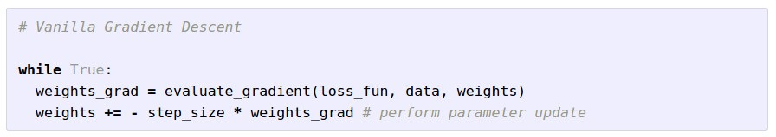
Optimization
(image credits
to Alec Radford)

Slide 2
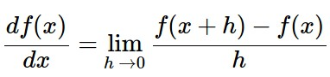
Gradient Descent
Numerical gradient: slow :(, approximate :(, easy to write :)
Analytic gradient: fast :), exact :), error-prone :(
In practice: Derive analytic gradient, check your implementation with numerical gradient

Slide 3
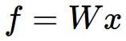

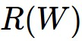
Computational Graph
x
*
s (scores)
hinge loss
+
L
W
R

Slide 4

Convolutional Network
(AlexNet)
input image
weights
loss

Slide 5
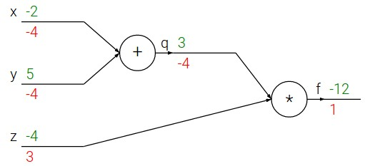
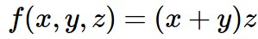
e.g. x = -2, y = 5, z = -4

Slide 6
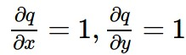
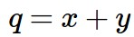
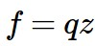
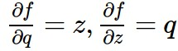
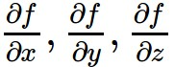
e.g. x = -2, y = 5, z = -4
Want:

Slide 7
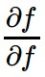
e.g. x = -2, y = 5, z = -4
Want:

Slide 8
e.g. x = -2, y = 5, z = -4
Want:

Slide 9
e.g. x = -2, y = 5, z = -4
Want:

Slide 10
e.g. x = -2, y = 5, z = -4
Want:

Slide 11
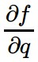
e.g. x = -2, y = 5, z = -4
Want:

Slide 12
e.g. x = -2, y = 5, z = -4
Want:

Slide 13
e.g. x = -2, y = 5, z = -4
Want:

Slide 14
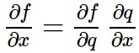
e.g. x = -2, y = 5, z = -4
Chain rule:
Want:

Slide 15
e.g. x = -2, y = 5, z = -4
Want:

Slide 16
e.g. x = -2, y = 5, z = -4
Chain rule:
Want:

Slide 17
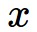
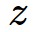
activations
f

Slide 18
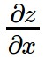
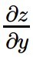
activations
f
“local gradient”

Slide 19
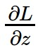
activations
f
“local gradient”
gradients

Slide 20
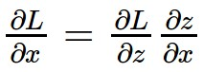
activations
f
“local gradient”
gradients

Slide 21
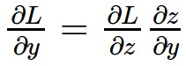
activations
f
“local gradient”
gradients

Slide 22
activations
f
“local gradient”
gradients

Slide 23
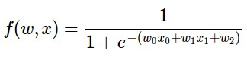
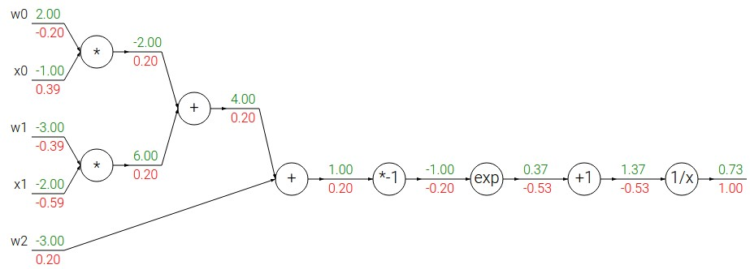
Another example:

Slide 24
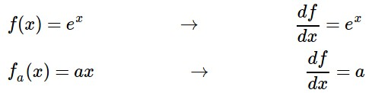
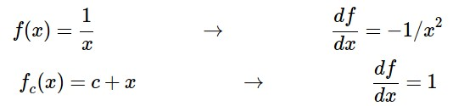
Another example:

Slide 25
Another example:

Slide 26
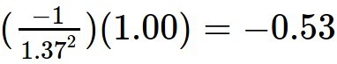
Another example:

Slide 27
Another example:

Slide 28
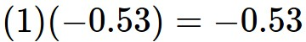
Another example:

Slide 29
Another example:

Slide 30
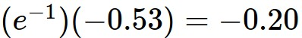
Another example:

Slide 31
Another example:

Slide 32
Another example:
(-1) * (-0.20) = 0.20

Slide 33
Another example:

Slide 34
Another example:
[local gradient] x [its gradient]
[1] x [0.2] = 0.2
[1] x [0.2] = 0.2 (both inputs!)

Slide 35
Another example:

Slide 36
Another example:
[local gradient] x [its gradient]
x0: [2] x [0.2] = 0.4
w0: [-1] x [0.2] = -0.2

Slide 37
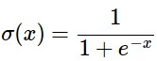
sigmoid function
sigmoid gate

Slide 38
sigmoid function
sigmoid gate
(0.73) * (1 - 0.73) = 0.2

Slide 39
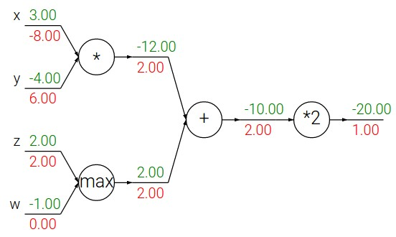
Patterns in backward flow
add gate: gradient distributor
max gate: gradient router
mul gate: gradient… “switcher”?

Slide 40
Gradients add at branches
+

Slide 41
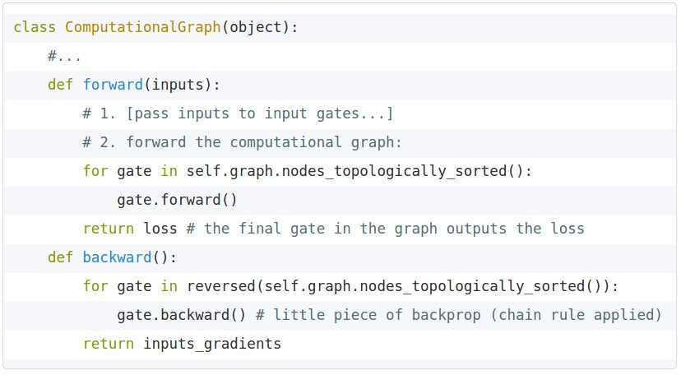
Implementation: forward/backward API
Graph (or Net) object. (Rough psuedo code)

Slide 42
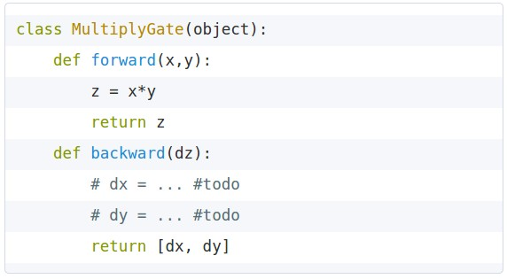
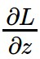
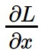
Implementation: forward/backward API
x
z
*
y
(x,y,z are scalars)

Slide 43
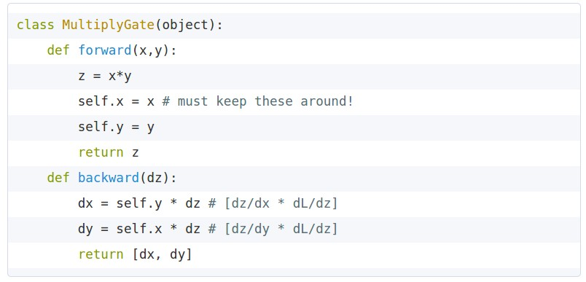
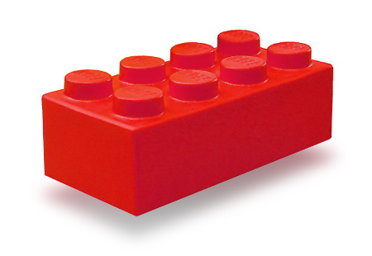
Implementation: forward/backward API
x
z
*
y
(x,y,z are scalars)

Slide 44
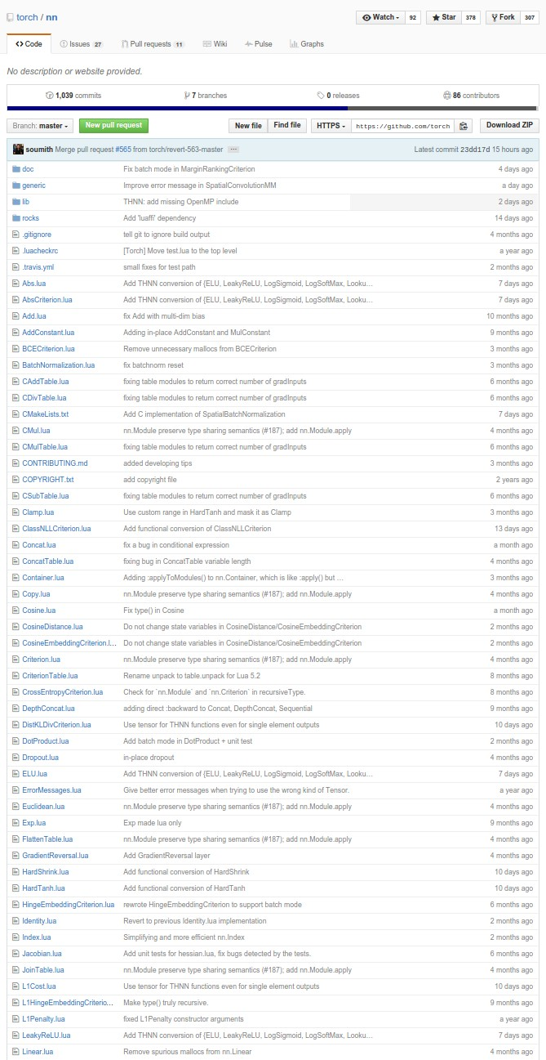
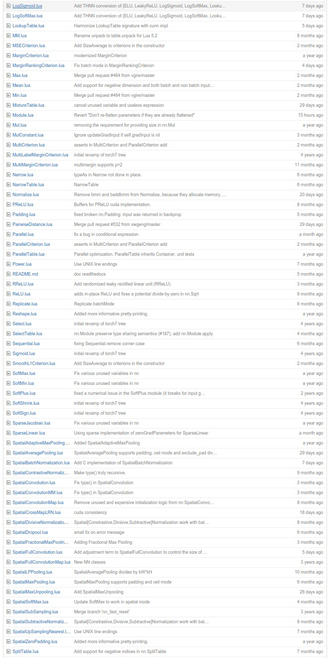
Example: Torch Layers

Slide 45
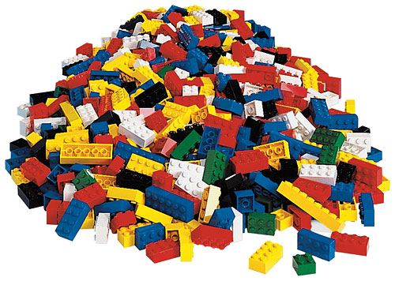
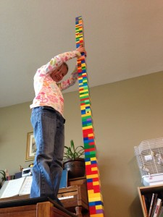

Example: Torch Layers
=

Slide 46
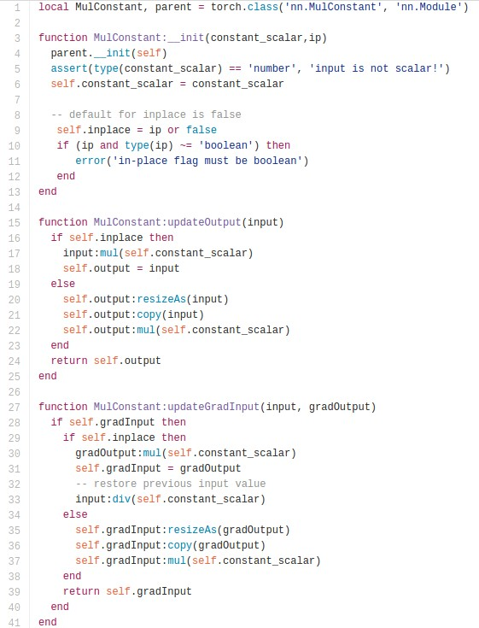
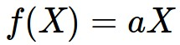
Example: Torch MulConstant
initialization
forward()
backward()

Slide 47
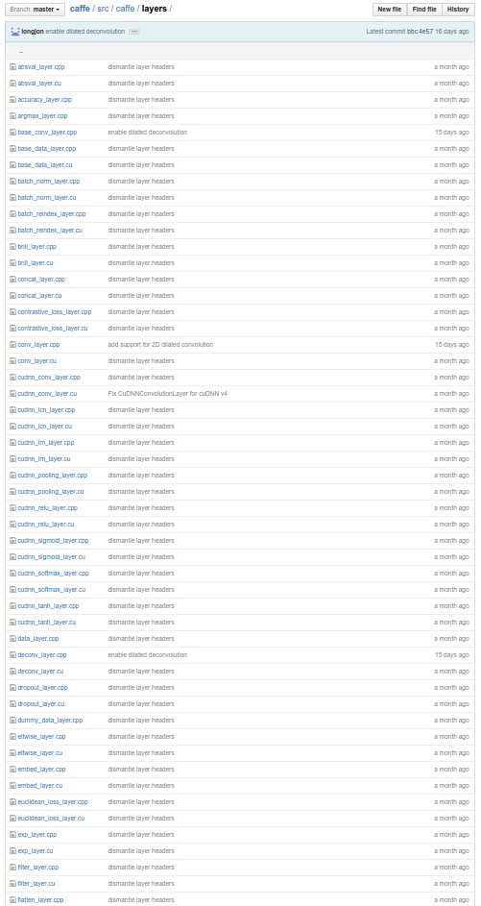

Example: Caffe Layers

Slide 48
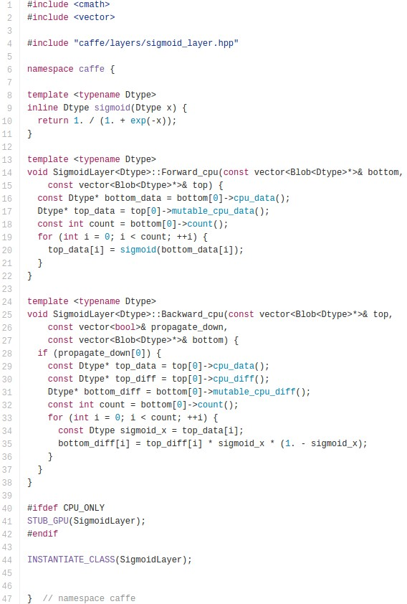
Caffe Sigmoid Layer
*top_diff (chain rule)

Slide 49
Gradients for vectorized code
(x,y,z are now vectors)
This is now the Jacobian matrix (derivative of each element of z w.r.t. each element of x)
f
“local gradient”
gradients

Slide 50
Vectorized operations
f(x) = max(0,x)
(elementwise)
4096-d
input vector
4096-d
output vector

Slide 51
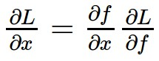
Vectorized operations
Jacobian matrix
f(x) = max(0,x)
(elementwise)
4096-d
input vector
4096-d
output vector
Q: what is the size of the Jacobian matrix?

Slide 52
Vectorized operations
Jacobian matrix
max(0,x)
(elementwise)
f(x) = max(0,x)
(elementwise)
4096-d
input vector
4096-d
output vector
Q: what is the size of the Jacobian matrix?
[4096 x 4096!]
Q2: what does it look like?

Slide 53
Vectorized operations
in practice we process an entire minibatch (e.g. 100) of examples at one time:
max(0,x)
(elementwise)
f(x) = max(0,x)
(elementwise)
100 4096-d
input vectors
100 4096-d
output vectors
i.e. Jacobian would technically be a
[409,600 x 409,600] matrix :\

Slide 54
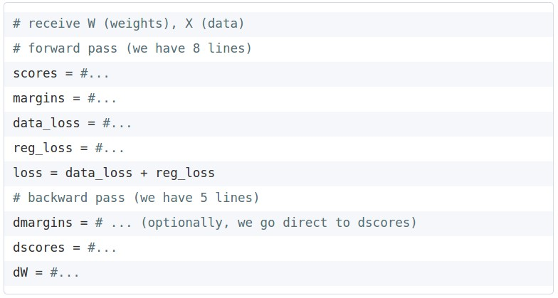
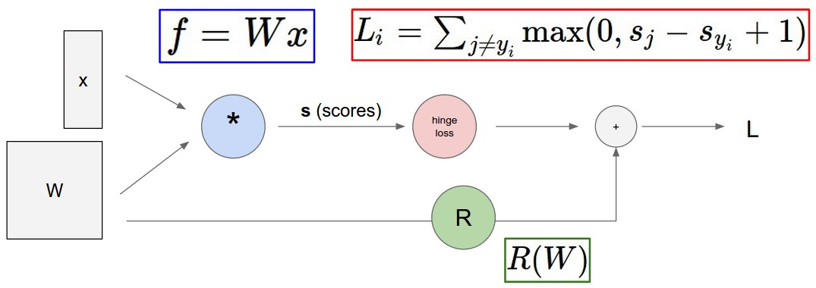
Assignment: Writing SVM/Softmax
Stage your forward/backward computation!
margins
E.g. for the SVM:

Slide 55
Summary so far
neural nets will be very large: no hope of writing down gradient formula by hand for all parameters
backpropagation = recursive application of the chain rule along a computational graph to compute the gradients of all inputs/parameters/intermediates
implementations maintain a graph structure, where the nodes implement the forward() / backward() API.
forward: compute result of an operation and save any intermediates needed for gradient computation in memory
backward: apply the chain rule to compute the gradient of the loss function with respect to the inputs.

Slide 56
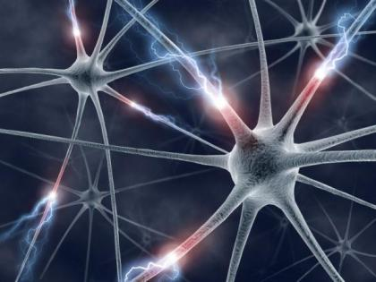

Slide 57
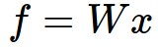
Neural Network: without the brain stuff
(Before) Linear score function:

Slide 58
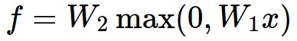
Neural Network: without the brain stuff
(Before) Linear score function:
(Now) 2-layer Neural Network

Slide 59
Neural Network: without the brain stuff
(Before) Linear score function:
(Now) 2-layer Neural Network
x
h
W1
W2
s
3072
100
10

Slide 60

Neural Network: without the brain stuff
(Before) Linear score function:
(Now) 2-layer Neural Network
x
h
W1
W2
s
3072
100
10

Slide 61
Neural Network: without the brain stuff
(Before) Linear score function:
(Now) 2-layer Neural Network
or 3-layer Neural Network

Slide 62

Full implementation of training a 2-layer Neural Network needs ~11 lines:
from @iamtrask, http://iamtrask.github.io/2015/07/12/basic-python-network/

Slide 63

Assignment: Writing 2layer Net
Stage your forward/backward computation!

Slide 65


Slide 66


Slide 67


Slide 68


sigmoid activation function

Slide 69


Slide 70

Be very careful with your Brain analogies:
Biological Neurons:
Many different types
Dendrites can perform complex non-linear computations
Synapses are not a single weight but a complex non-linear dynamical system
Rate code may not be adequate
[Dendritic Computation. London and Hausser]

Slide 71








Activation Functions
Leaky ReLU
max(0.1x, x)
Sigmoid
Maxout
tanh tanh(x)
ELU
ReLU max(0,x)

Slide 72


Neural Networks: Architectures
“3-layer Neural Net”, or
“2-hidden-layer Neural Net”
“2-layer Neural Net”, or
“1-hidden-layer Neural Net”
“Fully-connected” layers

Slide 73
Example Feed-forward computation of a Neural Network
We can efficiently evaluate an entire layer of neurons.

Slide 74

Example Feed-forward computation of a Neural Network

Slide 75

Setting the number of layers and their sizes
more neurons = more capacity

Slide 76

Do not use size of neural network as a regularizer. Use stronger regularization instead:
(you can play with this demo over at ConvNetJS: http://cs.stanford.edu/people/karpathy/convnetjs/demo/classify2d.html)

Slide 77
Summary
we arrange neurons into fully-connected layers
the abstraction of a layer has the nice property that it allows us to use efficient vectorized code (e.g. matrix multiplies)
neural networks are not really neural
neural networks: bigger = better (but might have to regularize more strongly)

